Slide 1
Introduction to Information and Communication Technologies
Lecture # 2
Department of Computer Science
The slides are adapted from the publisher’s material
Understanding Computers: Today and Tomorrow (Ch2)

Slide 2
Inside the System Unit
The system unit is the main body of a computer that houses essential electronic components responsible for processing data. These components are connected to the motherboard, which serves as the primary circuit board of the computer.
Key Features of the System Unit:
Purpose: Protects and holds key electronic components such as the processor, memory, hard disk, and other essential hardware.
Material: Typically made of plastic or metal to ensure durability and protection.

Slide 3
Inside the System Unit
Types of System Units:
Tower Model:
Used in desktop computers.
Stands vertically on the desk.
All-in-One Computer:
Integrates the system unit and monitor into a single case.
Laptop Computer:
The keyboard and pointing devices are built onto the system unit.
Slate Tablet:
The system unit is located behind the display screen.

Slide 4
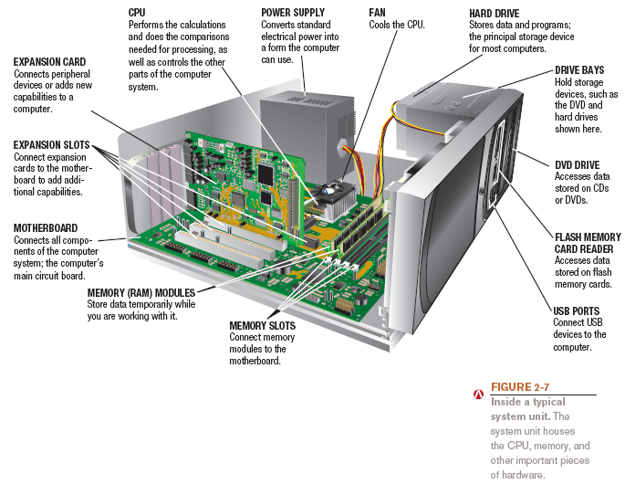
Inside the System Unit
Physical interfaces that allow cables and devices to connect properly.
Notes:
-Power supply: Converts AC to DC
Most wall outlets provide Alternating Current (AC), but computer components require Direct Current (DC). The Power Supply Unit (PSU) converts AC into DC at the necessary voltages.
-A bay in computing and hardware refers to a physical space inside a computer case or other electronic device designed to hold and mount components like hard drives, SSDs, CD/DVD drives, or cooling systems.

Slide 5
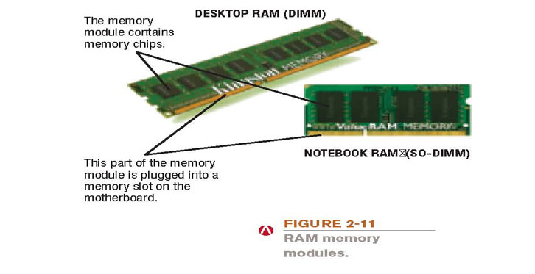
Memory

Slide 6
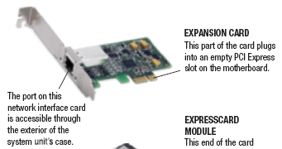
Expansion Slots, Expansion Cards
Expansion slot: A location on the motherboard into which expansion cards are inserted
Expansion card: A circuit board used to add additional functionality or to attach a peripheral device

Slide 7
Ports and Connectors
Port: An interface or connection point on the exterior of a computer’s system unit to which a peripheral device is attached.
Connector:
Physical interfaces that allow cables and devices to connect properly.

Slide 8
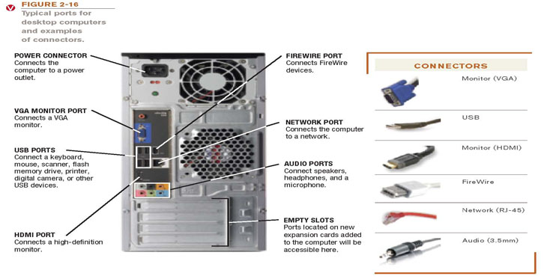
Ports and Connectors

Slide 9
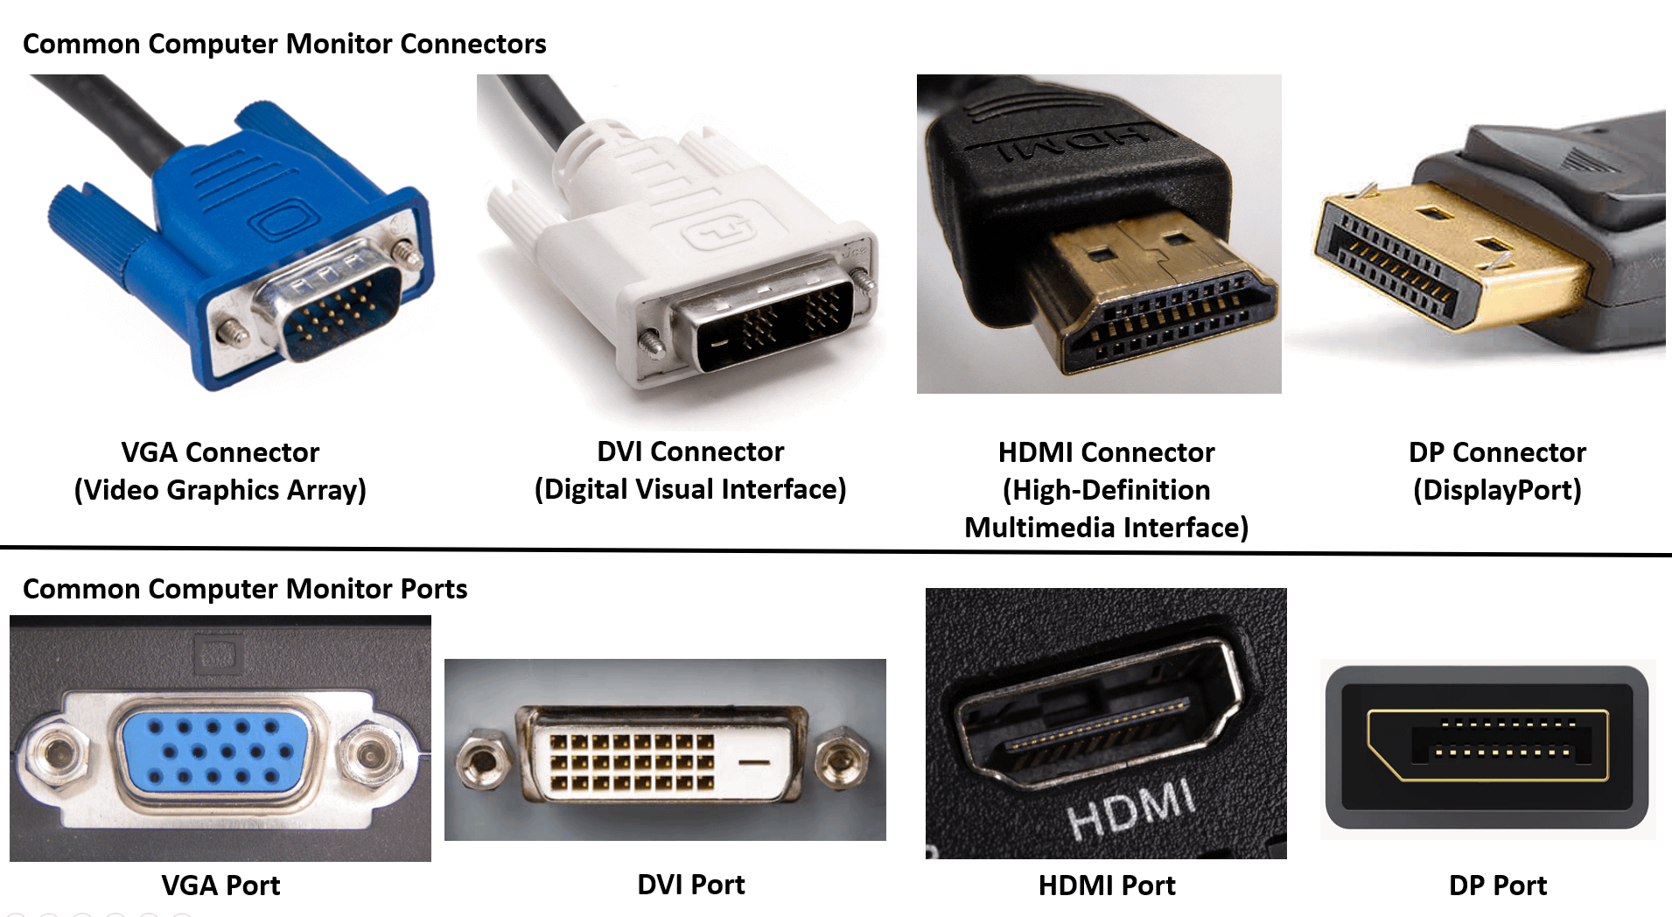

Slide 10
The Motherboard
Motherboard or system board: The main circuit board inside the system unit. Also called main board/ system board.
A communication medium for the entire computer system.
All devices must connect to the motherboard.
Houses essential components like the processor, memory, expansion slots.

Slide 11
The CPU- Brain of the computer
Central processing unit (CPU): connected directly to the motherboard
Does the vast majority of processing for a computer
Processes calculations and transfers data between different components.
Also called a processor; called a microprocessor when talking about personal computesr

Slide 12
Multi-core processors
All functions of the processor usually are on a single chip in personal computers.
The manufacturers of processor chips are also producing multi-core processors.
A single chip that contains two or more separate processors is known as a multi-core processor.
Multi-core processing reduces access time and increases overall processing speed.

Slide 13
Multi-core processors
For example, if one core is busy executing an instruction, another can handle incoming data or instructions.
Multi-core processors include dual-core, quad-core, six-core, and eight-core. AMD and Intel offer multi-core processors.

Slide 14
Multi-core processors
Two common multi-core processors are as follows:
Dual-core Processor
A dual-core processor chip contains two separate processors.
Quad-core Processor
A quad-core processor chip contains four separate processors.

Slide 15
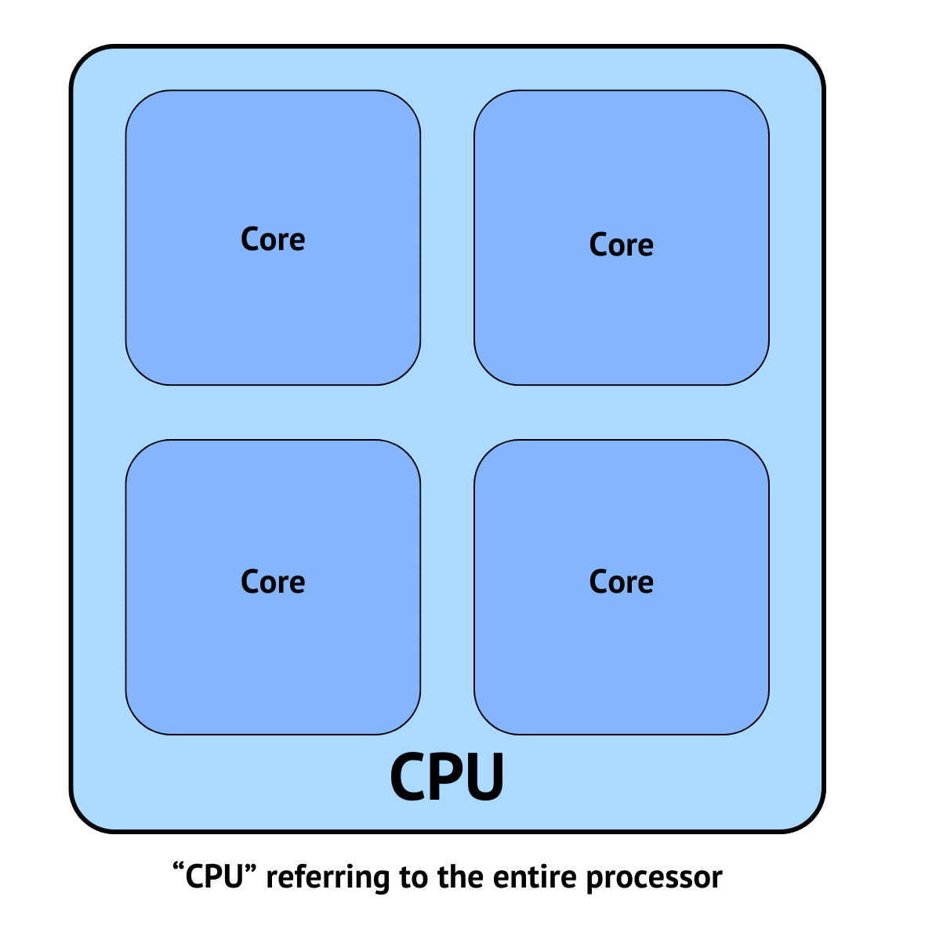
The CPU

Slide 16
The CPU
Does i7 Always Mean 7 Cores?
❌ No! The "7" in i7 does NOT mean 7 cores.
An i7-13700K has 16 cores (8 performance + 8 efficiency cores).
An older i7-7700K had only 4 cores.
The actual core count and speed change between generations!

Slide 17
The CPU
CPU Components
The CPU consists of two main units:
Arithmetic & Logic Unit (ALU)
Control Unit (CU).
CPU Instruction Cycle/Machine Cycle/ Fetch-Decode-Execute Cycle.
Already discussed in lecture 1 slides

Slide 18
Instruction Set
A set of all instructions that can be performed by a CPU is called an instruction set. The instruction set consists of the following types of instructions:
Arithmetic Instructions
Logical Instructions
Data Transfer Instructions
Control Transfer Instructions

Slide 19
1. Arithmetic Instructions
The instructions used to perform arithmetic operations are called arithmetic instructions. Different arithmetic operations are addition, subtraction, multiplication, and division.
These instructions are executed by the Arithmetic & Logic Unit (ALU) of the CPU.

Slide 20
2. Logical Instructions
The instructions used to perform logical operations are called logical instructions. A logical operation is the comparison of two data values. Possible comparisons are:
Greater than (>)
Equal to (==)
Less than (<)

Slide 21
3. Data Transfer Instructions
The instructions used to transfer data from one component to another during program execution are called data transfer instructions.

Slide 22
4. Control Transfer Instructions
The instructions used to change the sequence of instructions of a program are called control transfer instructions. These instructions transfer execution control to a certain part of the program instead of the next instruction.

Slide 23
Processing Speed
Processing speed refers to how fast a computer’s CPU (Central Processing Unit) can execute instructions. It determines how quickly a computer can perform tasks like opening programs, running calculations, or processing data.

Slide 24
Processing Speed
How is Processing Speed Measured?
Processing speed is typically measured in Hertz (Hz), which indicates the number of cycles (operations) a processor can perform per second.

Slide 25
System clock
A system clock is an electronic component that generates generates electronic pulses (clock cycles) at a rapid speed, and each pulse tells the CPU to process the next step of an instruction. The more pulses per second, the faster the CPU can work.
Processing speed:
the speed of the CPU is measured in clock cycles. A computer clock can tick from millions to billions of times per second.

Slide 26
Processing Speed
Megahertz (MHz) = millions of cycles per second
Gigahertz (GHz) = billions of cycles per second
For example, a 3.0 GHz processor can handle 3 billion operations per second. However, clock speed isn't the only factor affecting performance—other components like the CPU architecture, number of cores, and cache memory also play a big role.

Slide 27
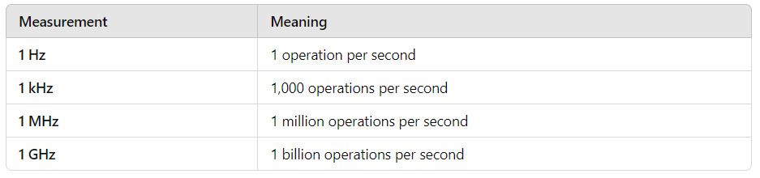
Processing Speed

Slide 28
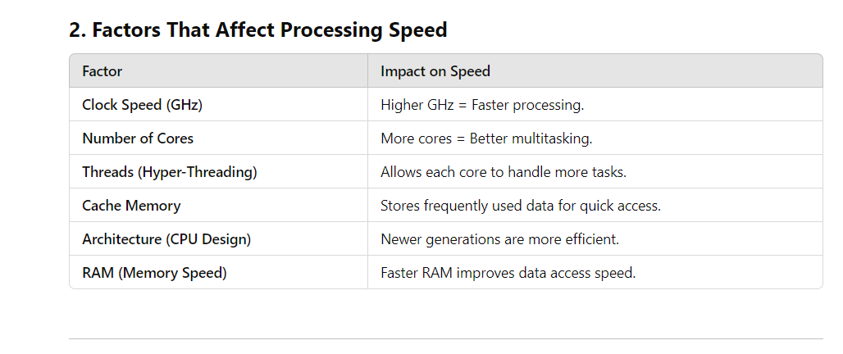
Processing Speed

Slide 29
Pipelining
Pipelining is a technique in which the CPU starts the next instruction before finishing the current one. This allows multiple instructions to be processed at the same time, increasing speed and efficiency.

Slide 30
Pipelining
Without pipelining, the CPU completes one full instruction (fetch → decode → execute → store) before starting the next. This is slower because each step must wait for the previous one to finish.
With pipelining, different steps of multiple instructions overlap, so while one instruction is being executed, the next one is already being decoded. This speeds up processing and improves computer performance.

Slide 31
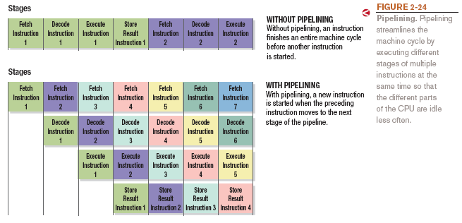
Pipelining

Slide 32
Memory
Memory is the part of a computer that stores data and instructions so the CPU can use them when needed. It is made up of small storage locations called cells. Each cell stores a bit (0 or 1), and eight bits together form a byte.
Bit=binary digit

Slide 33
Memory
Structure of Main Memory
The memory consists of thousands or millions of storage locations.
Each byte has a unique address (like a house number) that helps the CPU find and access it quickly.

Slide 34
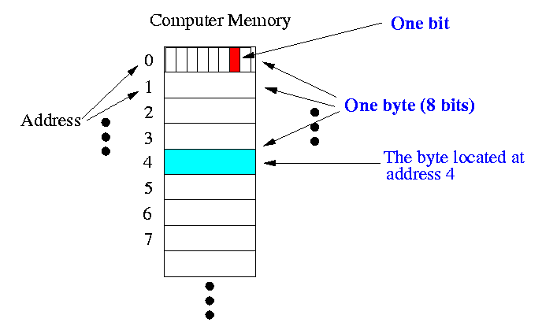

Slide 35
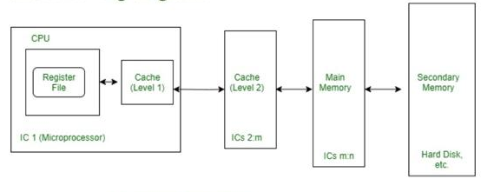
Memory Hierarchy

Slide 36
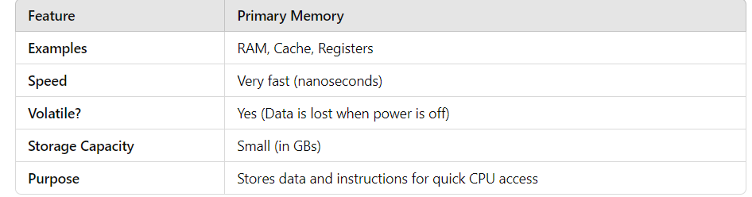
Types of memory
Primary Memory (Volatile Memory)
🔹 Definition → Primary memory is the main memory of a computer, used for temporary data storage while the system is running. 🔹 Fastest memory but temporary (volatile)—data is lost when power is turned off.

Slide 37
Types of Primary Memory:
RAM (Random Access Memory) → Stores active programs and data (temporary storage).
Cache Memory → Small, high-speed memory close to the CPU for quick data access. Level 1 is fastest, then Level 2, then Level 3. More cache memory typically means faster processing
Registers → Ultra-fast memory inside the CPU, used for immediate calculations.
💡 Example: If you're working on a Word document, the content is stored in RAM while you're typing. If the power goes off, the document is lost unless saved.

Slide 38
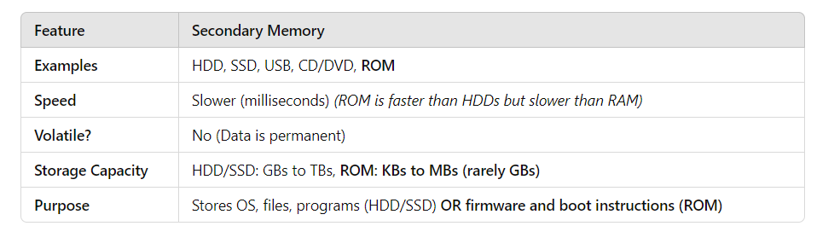
. Secondary Memory (Non-Volatile Memory)
🔹 Definition → Secondary memory is permanent storage, used to store data and programs long-term. 🔹 Slower than primary memory but retains data even after power is turned off.
Notes:
HDD Uses magnetic fields to store data
SSD-Solid state device uses flash memory to store data. E.g usb

Slide 39
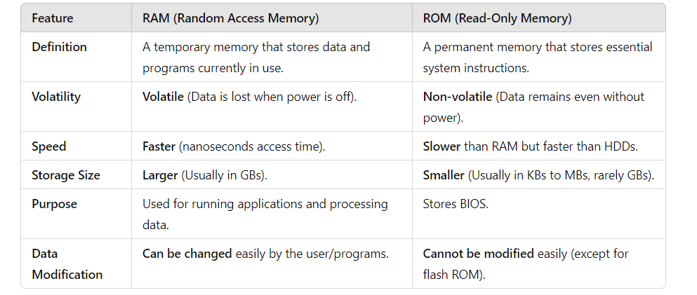
RAM VS ROM

Slide 40
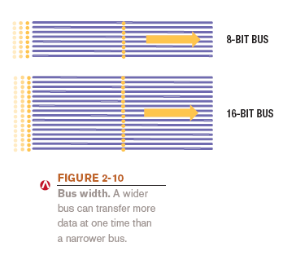
Bus Width, Bus Speed, and Bandwidth
Bus:
An electronic path over which data can travel between different components of computer.
allowing different parts (CPU, memory, storage, and peripherals) to communicate with each other efficiently.

Slide 41
Bus Width
The capacity of a bus depends on the number of data lines in it.
The amount of data that a bus can carry at one time is called bus width. A higher bus width means that the bus can carry more data. It increases the performance of the computer.
A bus with 32 lines can carry 32 bits or 4 bytes at a time. A bus with 64 lines can carry 64 bits or 8 bytes at a time.

Slide 42
Bus Speed
The speed at which data moves from one component to another component of the computer is called bus speed.
Bus width and speed determine the throughput (or bandwidth) of the bus
The amount of data that can be transferred by the bus in a given time period

Slide 43
Interaction between CPU and RAM
RAM and CPU are both placed on the motherboard. RAM is a temporary memory that stores data and instructions for the CPU. The CPU takes data and instructions from RAM when required. CPU also places processed data in RAM. The interaction between CPU and RAM takes place every time an instruction is executed. This interaction takes place with the help of the computer bus.

Slide 44
Interaction between CPU and RAM
RAM is connected to the CPU through the data bus, control bus, and address bus. It is collectively known as the system bus. The system bus consists of electrical paths to transfer information between the CPU and RAM.
The following steps are performed when the CPU wants to read data from RAM:
CPU places the read request on the control bus.
CPU places the address of the required byte or word on the address bus.
Memory unit reads the command and address. It puts the required data on the data bus.
CPU reads the data from the data bus.

Slide 45
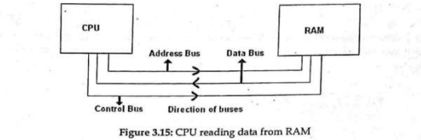

Slide 46
Interaction between CPU and RAM
The following steps are performed when the CPU wants to write data to RAM:
CPU places the write request on the control bus.
CPU places the address of the word where to write data on the address bus.
Memory unit gets ready to do the operation.
CPU puts data on the data bus.
Memory unit reads the data and places it in the required word.

Slide 47
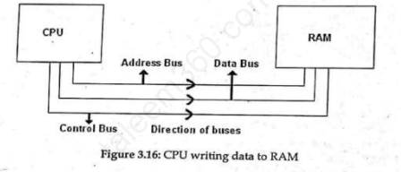

Slide 48
Quick Quiz
1. Which type of memory is erased when the power goes out?
a. ROM
b. RAM
c. flash memory
2. True or False: The CPU can also be called the motherboard.
3. A(n) electronic path within a computer over which data travels is called a(n) _____________.
Answers:
1) b; 2) False; 3) bus

Slide 49
Making Computers Faster and Better Now and in the Future
Improving performance today
Add more memory
Perform system maintenance
Uninstall programs properly
Consider placing large files on external storage devices
Delete temporary files
Scan for viruses and spyware
Buy a larger or second hard drive
Upgrade your Internet connection
Upgrade your video graphics card

Slide 50
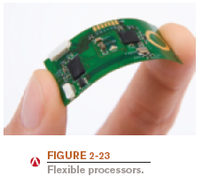
Making Computers Faster and Better Now and in the Future
Strategies for faster and better computers
Improved architecture: faster bus speeds, multiple CPU cores, etc.
Pipelining: Allows multiple instructions to be processed at one time
Multiprocessing and parallel processing: Use multiple processors to speed up processing

Slide 51
Future Trends in computing
CLASS Activity

